Slide 1
Example Figures

Slide 2
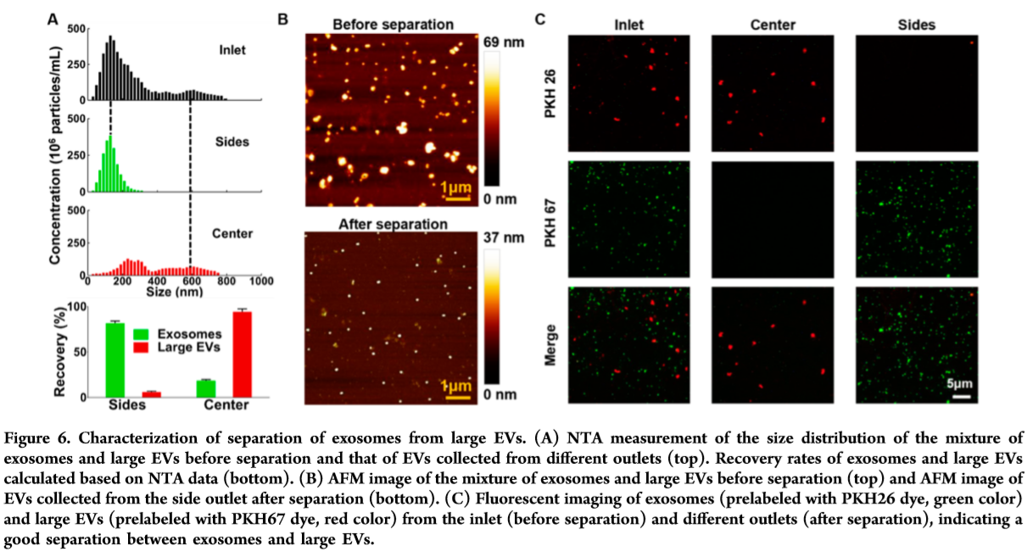
FIGURE

Slide 3
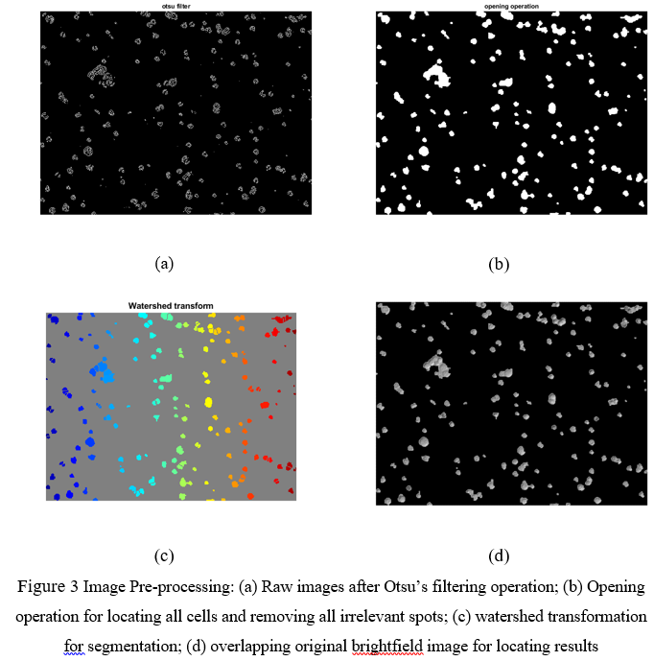

Slide 4
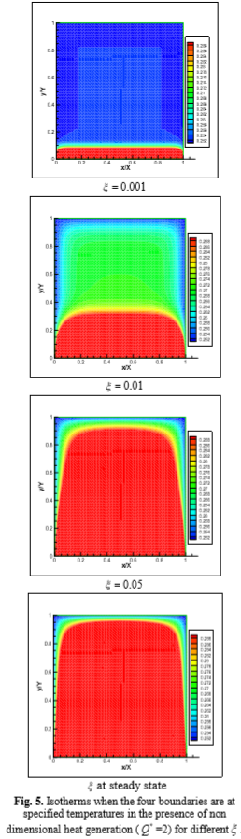

Slide 5
Crystal Axis
TD
$$\overset{⃑}{E}$$
RD

